Slide 1



Organosulfurs in Meteorites
Jacob Eaton
Dr. Maitrayee Bose, ASU School of Earth and Space Exploration
NASA Space Grant Symposium
April 22nd, 2023

Slide 2
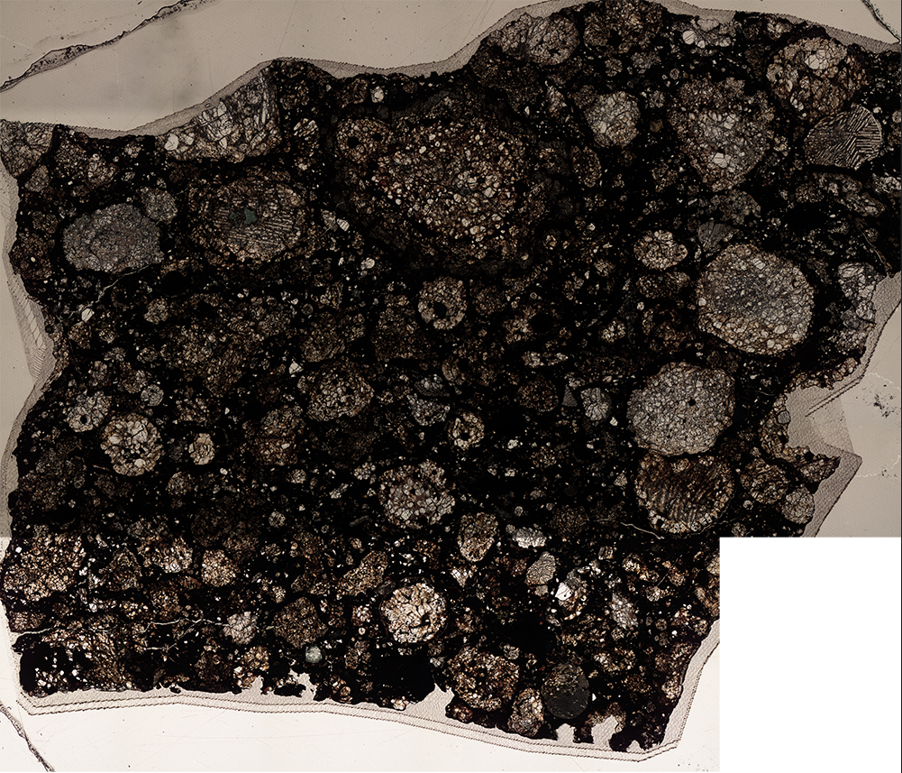
Introduction
Identify thiol groups on the meteorites GRA 95229 and Murchison
Thiol is found in many important organic molecules
Understanding the location and amount of thiol on these meteorites helps shed light on the formation of thiol and other organic molecules in space

Slide 3
Methodology
X-Ray Absorption Near Edge Structure (XANES) spectroscopy
  K-Edge Sulfur XANES
Measurements taken at the Stanford Synchrotron Radiation Lightsource (SSRL)
310 distinct spectra taken

Slide 4
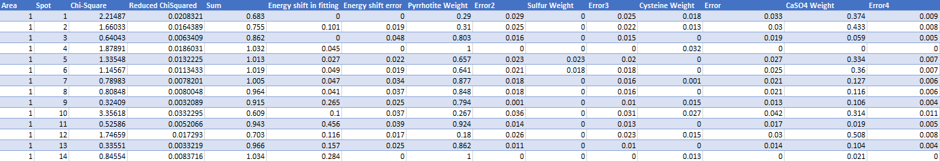
Analysis
Linear combination fitting in the program Athena
Spectra normalized and then modeled with the standard spectra of pyrrhotite, elemental sulfur, cysteine, and calcium sulfate
  Cysteine as a proxy for thiol, calcium sulfate as a proxy for sulfates

Slide 5
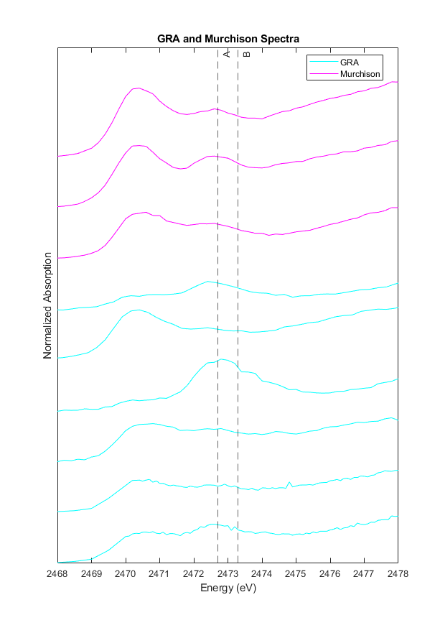
Results
Nine spectra with significant thiol content
Six located in GRA, three located in Murchison
Line A denotes the elemental sulfur peak (2472.7 eV), Line B denotes the thiol peak (2473.3 eV)
All spectra close to or exceeding 5% thiol by mass

Slide 6
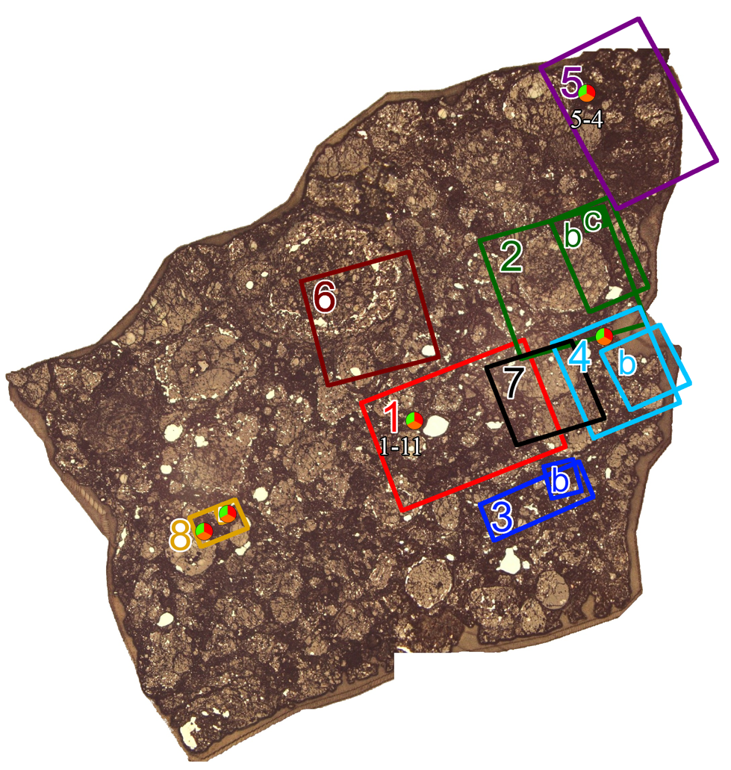
Results
GRA with its mapped areas and most prominent thiol spectra denoted
Red denotes sulfate, green denotes thiol, orange denotes sulfide

Slide 7
Conclusions and Future Work
  Significant amount of thiol found in GRA and Murchison
  Creation of additional figures relating to distribution of sulfates and sulfides
  Mineralogy data to investigate correlations between thiol and other elements like phosphorus
  Comparisons with data from Ryugu
  Jacob Eaton – jbeaton6@asu.edu, Arizona State University
  Acknowledgements: Supported in part through the Arizona NASA Space Grant Consortium, Cooperative Agreement 80NSSC20M0041.

Slide 8
Thank You!

